Slide 1
Comprehensive guide to simple invoice generation application development
Exploring project objectives, technologies, Architecture, UIdesign, Testing and deployment

Slide 2
Table of contents
Introduction to Simple invoice Generation Application
Project Objectives and Technologies Used
Backend Architecture and Security Features
System and Hardware Requirements
Android Development Environment Setup
Development Workstation Requirements
REST APIs for Invoice Management

Slide 3
Table of contents
UI Design and Architecture Overview
Dashboard Feature and Data Communication
Testing Methods and Entity-relationship Diagram
Project Execution Steps
Networking and App Deployment

Slide 4
Introduction The Simple Invoice Generation Application
____________________________________________________________________________________
Introduction The Simple Invoice Generation Application
The Simple Invoice Generation Application is designed to simplify the process of creating and managing invoices for individual users.
This project comprises two main components: a native Android client and a RESTful API backend developed using Spring Boot.

Slide 5
Features
________________________________________________________________________________
1. User Registration
Users must register with a unique username, password, and email.
Additional information collected includes the date of account creation.
2. Invoice Management
Registered users can create multiple invoices, each linked to a user account.
Invoice creation requires the client name (minimum 5 characters), invoice amount (positive and at least INR 3000), invoice date (past or current date), and a description
(optional).
All fields except the description are mandatory.
3. Dashboard
Upon login, users see a dashboard displaying a list of invoices they have created.

Slide 6
4. Invoice Details View:
Clicking an invoice in the dashboard opens a detailed view showing all relevant information about the invoice.
5. Invoice Editing:
Users can edit existing invoices, modifying the client name, amount, date, and description.
6. Invoice Deletion:
Users can delete invoices after confirming the action through a dialog prompt.

Slide 7
Project Rationale
__________________________________________________________________________________
This project is developed as a capstone project to help us to gain hands-on experience in building full-stack applications.
It aims to:
Provide practical experience in Android app development using Kotlin.
Teach the development of RESTful APIs using Spring Boot in Java.
Illustrate the integration of frontend and backend systems.
Demonstrate best practices in validation, error handling, and user interface design.

Slide 8
Technologies Used
__________________________________________________________________________________
Frontend: Android application developed using Kotlin.
Backend: RESTful API developed using Spring Boot (Java).

Slide 9
Backend Development with Spring Boot
__________________________________________________________________________________
Create Spring Boot Project:
Go to [Spring Initializr](https://start.spring.io/).
Project: Maven Language: Java Spring Boot: 3.2.5
Fill in the project metadata:
Group: com.example
Artefact: invoice-app
Name: invoice-app
Description: Simple Invoice Generation Application
Package name: com.example.invoiceapp
Packaging: Jar
Java: 17

Slide 10
Dependencies:
Spring Web
Spring Data JPA
MySQL Driver
Spring Boot DevTools
Lombok
Backend Architecture:
Authentication:
User authentication is managed using Spring Security.
Upon registration, user credentials are stored securely using hashed passwords.
During login, users are authenticated, and a session token (JWT) is generated and returned to the client for subsequent requests.

Slide 11
System and Hardware Requirements
________________________________________________________________________
System Requirements for backend server
Operating System:
Linux (Ubuntu, CentOS, etc.)
Windows 10 or later
macOS
Java Development Kit (JDK):
JDK 11 or later
Build Tool:
Maven 3.6 or later
Database:
MySQL 5.7 or later
PostgreSQL 12 or later
H2 Database (for development and testing purposes)

Slide 12
System and Hardware Requirements
___________________________________________________________________________________
Spring Boot: Spring Boot 2.4 or later
Other Tools:
IDE: IntelliJ IDEA, Eclipse, or any other preferred Java IDE
Postman (for API testing)
Git (for version control)
Android Client - Operating System:
Windows 10 or later
macOS
Linux
Android Studio: Android Studio 4.0 or later
Android SDK: Android SDK 29 or later
Kotlin: Kotlin 1.3 or later
Emulator: Android Emulator with Android 10 (API level 29) or later

Slide 13
Common Development Tools
Version Control: Git (with GitHub, GitLab, or Bitbucket for repository hosting)
Communication:Slack, Microsoft Teams, or any preferred communication tool for team collaboration
Hardware Requirements
Backend Server
Processor: Quad-core CPU (Intel Core i5 or AMD equivalent)
Memory: 8 GB RAM minimum (16 GB recommended for better performance)
Storage:100 GB available SSD space (to accommodate the database, server logs, and other dependencies)
Network:Reliable high-speed internet connection

Slide 14
Development Workstation (for Android and Backend Development)
Processor:Intel Core i5 (8th Gen or later) or AMD Ryzen 5 (3rd Gen or later)
Memory:16 GB RAM minimum (32 GB recommended for smooth multitasking)
Storage:256 GB SSD minimum (512 GB recommended to handle project files, IDEs, and emulators)
Graphics: For Testing and Deployment
Testing Devices:
Physical Android devices with various screen sizes and OS versions (Android 8.0 Oreo to the latest version)
Continuous Integration/Continuous Deployment (CI/CD):
Jenkins, GitHub Actions, GitLab CI, or any other CI/CD tool for automated testing and deployment

Slide 15
RESTful API Development
__________________________________________________________________________________
Number of REST APIs Needed:
User: Register User and Login User
Invoice: Create Invoice Update Invoice
Delete Invoice Get All Invoices
Get Invoice Details
In total, 7 REST APIs are needed.
API Endpoints:
User Registration: `POST /api/register`
User Login: `POST /api/login`
Invoice Creation: `POST /api/invoices
Get Invoices: `GET /api/invoices`
Get Invoice Details: `GET /api/invoices/{id}`
Update Invoice: `PUT /api/invoices/{id}`
Delete Invoice: `DELETE /api/invoices/{id}`

Slide 16
Frontend Architecture:
___________________________________________________________________________
Android Project: Name Of project as "Simple Invoice Generation Application".
language as Kotlin.
1. UI Design:
The app follows a Model-View-ViewModel (MVVM) architecture.
Activities and Fragments represent the View, ViewModels handle the logic, and LiveData is used to update the UI reactively.
2. User Interface:
Login and Registration Screens: Allow users to register and log in.
Dashboard: Displays a list of invoices.
Invoice Detail View: Shows detailed information about a selected invoice.
Invoice Form: Used for creating and editing invoices.

Slide 17
App Workflow:
___________________________________________________________________________________
1. User Registration and Login:
Users register by providing their username, password, and email.
After registration, they can log in, which authenticates them and provides a session token.
2. Invoice Management:
Users can create new invoices by entering the required details.
The dashboard shows all invoices created by the logged-in user.
Users can view, edit, or delete invoices from the dashboard.

Slide 18
Communication with Backend:
JSON Passing:
Data is exchanged between the Android app and the backend using JSON.
Retrofit library is used on the Android side to make API calls.
GSON is used to parse JSON responses into Kotlin data classes.

Slide 19
Data Validation and Error Handling
_______________________________________________________________________
Both Android and Spring Boot implement data validation and error handling to ensure data inputs.
Spring Boot API returns error responses in case of validation failures or other errors, which are handled by the Android application.

Slide 20
Key Notes
_________________________________________________________________________
Security:
Implement proper authentication and authorization to ensure user data security.
Validation:
Perform thorough input validation to ensure data integrity and application.
Testing:
unit and integration tests to ensure the reliability and stability of the application.

Slide 21
Entity-Relationship (ER) diagram for your Simple Invoice Generation Application:
| User | | Invoice |
| id: int | | id: int |
| username: Stri | | clientName: String |
| password: String | | amount: Double |
| email: String | | date: LocalDate |
| createdAt: LocalDateTime | | description: String |
| user_id: int |

Slide 22
User table/entity: Invoice table/entity:
id: int (Primary Key) amount: Double
username: String date: LocalDate
password: String description: String
email: String user_id: int (Foreign Key referencing User table)
createdAt: LocalDateTime
id: Long (Primary Key)
clientName: String
One user can have multiple invoices (One-to-Many relationship between User and Invoice).

Slide 23
Backend Setup:
__________________________________________________________________________________
Environment: Install Java, Spring Boot, and a relational database (e.g., MySQL).
Project Initialization: Use Spring Initializr to create a new Spring Boot project with dependencies such as Spring Web, Spring Data JPA, and Spring Security.
Database Configuration: Set up the database schema and connection properties in `application.properties`.
Security Configuration: Implement user authentication and authorization using Spring Security.
API Development: Define entities, repositories, and controllers for user and invoice management.
Run the Backend: Use `mvn spring-boot:run` to start the backend server.

Slide 24
Frontend Setup
__________________________________________________________________________
Environment: Install Android Studio.
Project Initialization: Create a new Android project with Kotlin as the language.
UI Design: Design the UI using XML layouts and implement the necessary Activities and Fragments.
Networking: Set up Retrofit for API calls and GSON for JSON parsing.
ViewModel and LiveData: Implement ViewModels to handle business logic and use LiveData to observe data changes.
Validation: Add form validation to ensure user inputs are correct before sending data to the backend.
Run the App: Build and run the app on an emulator or physical device.

Slide 25
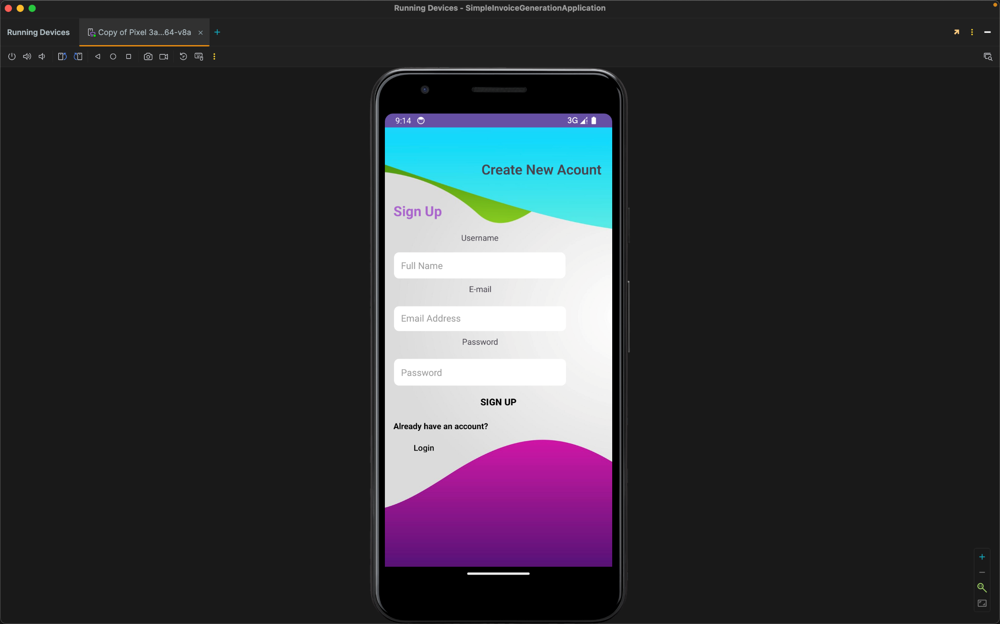
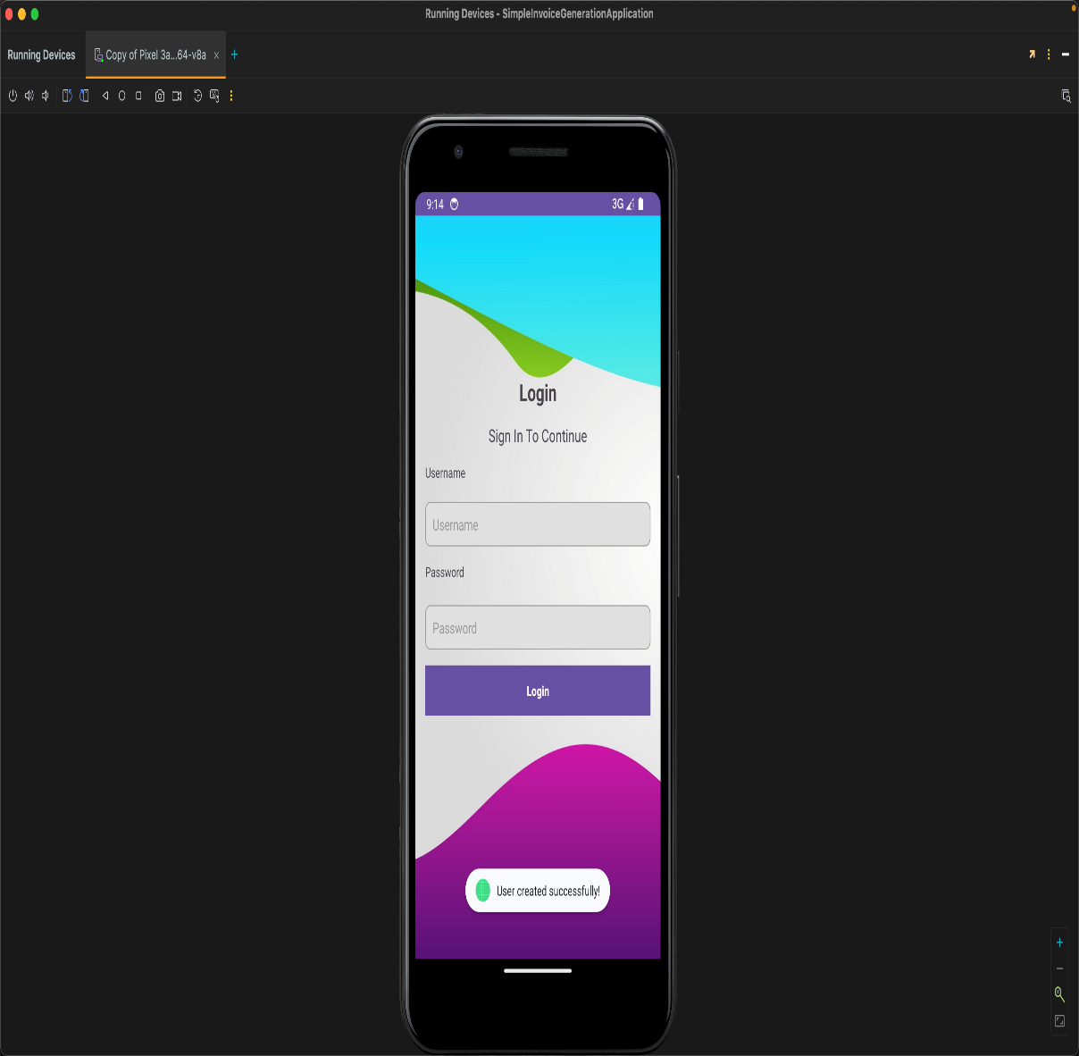
Application Review

Slide 26
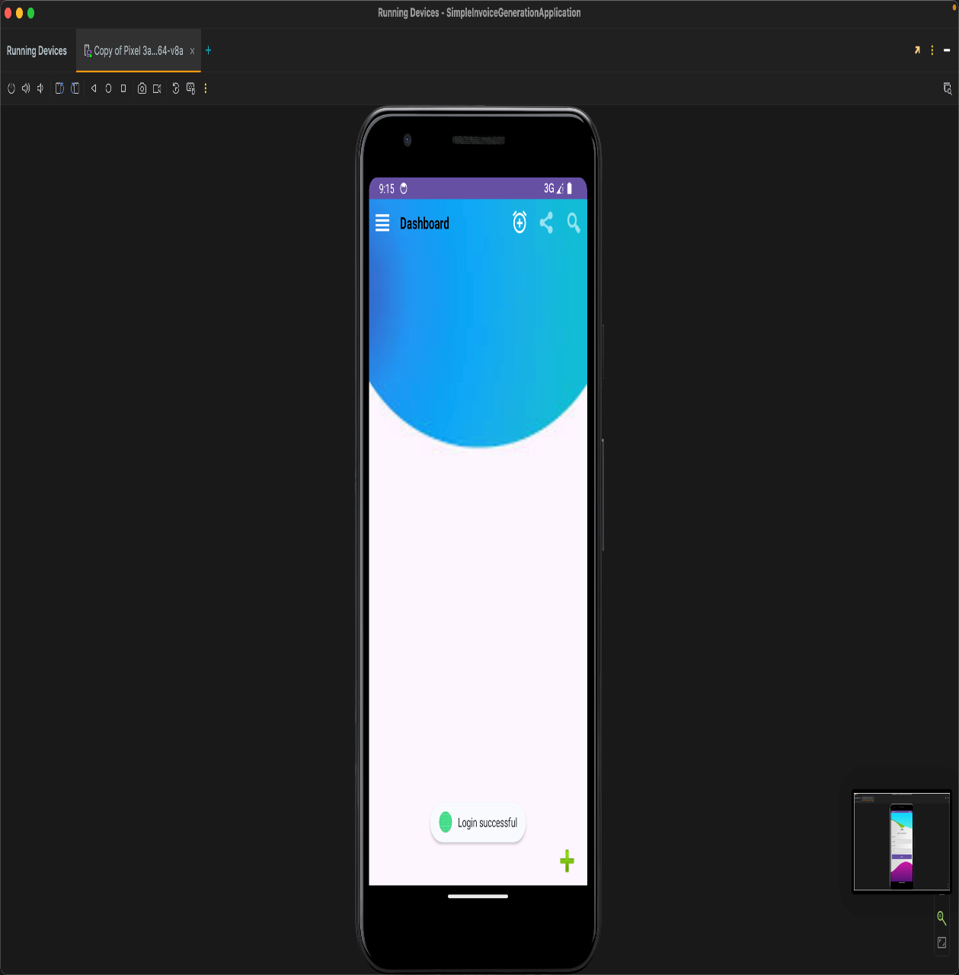
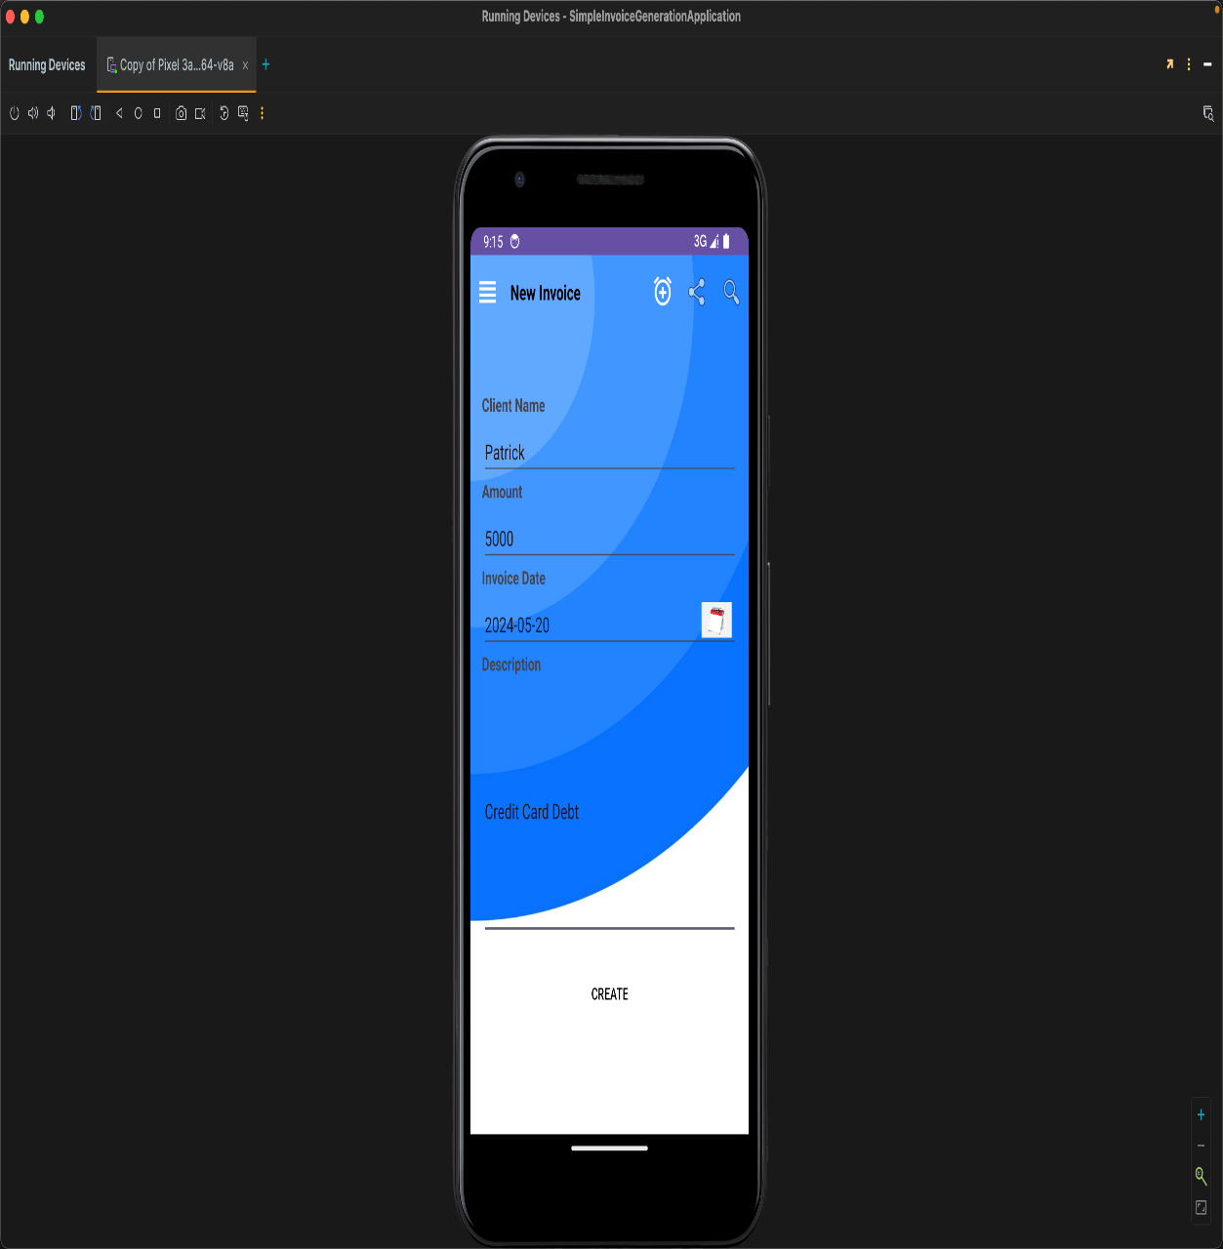
Application Review

Slide 27
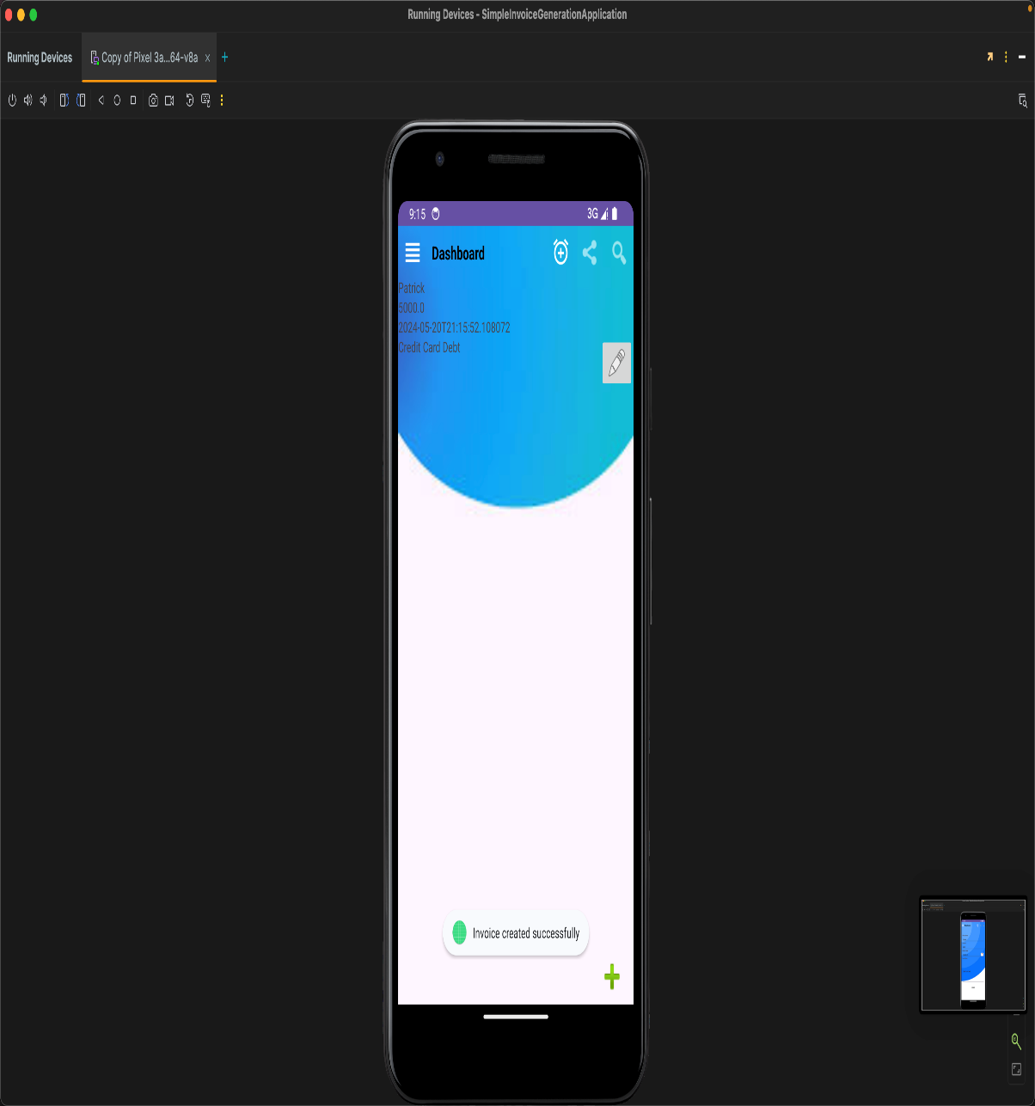
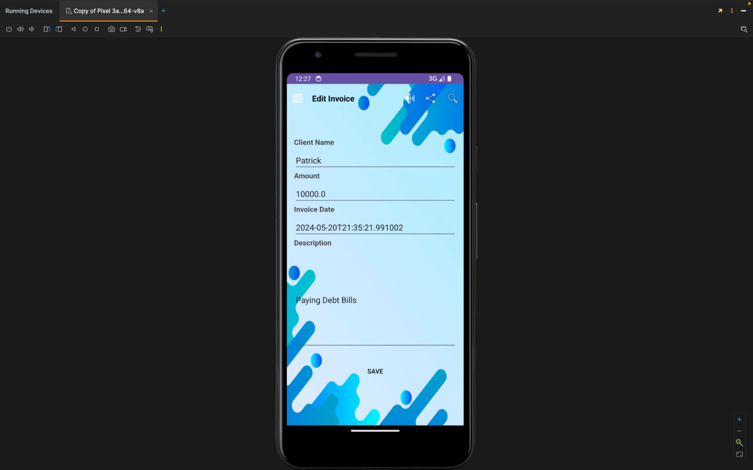
Application Review

Slide 28
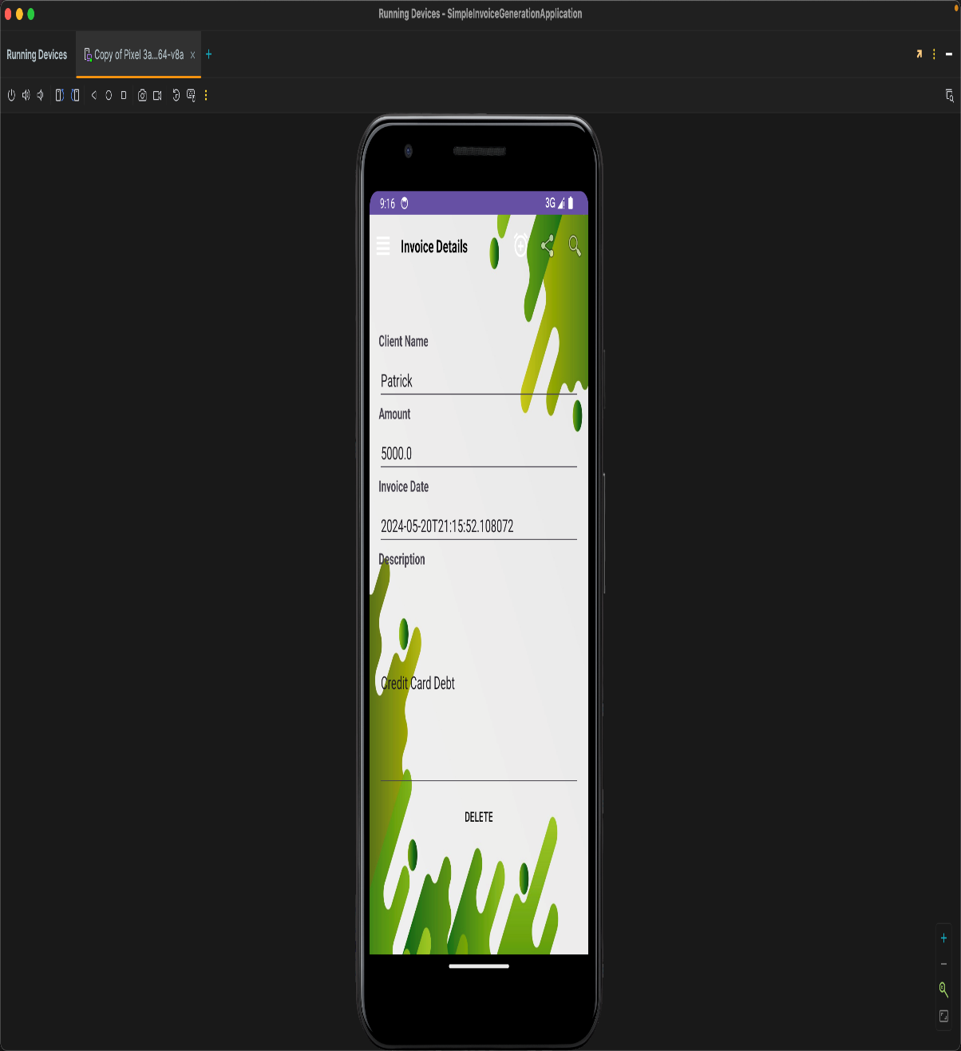
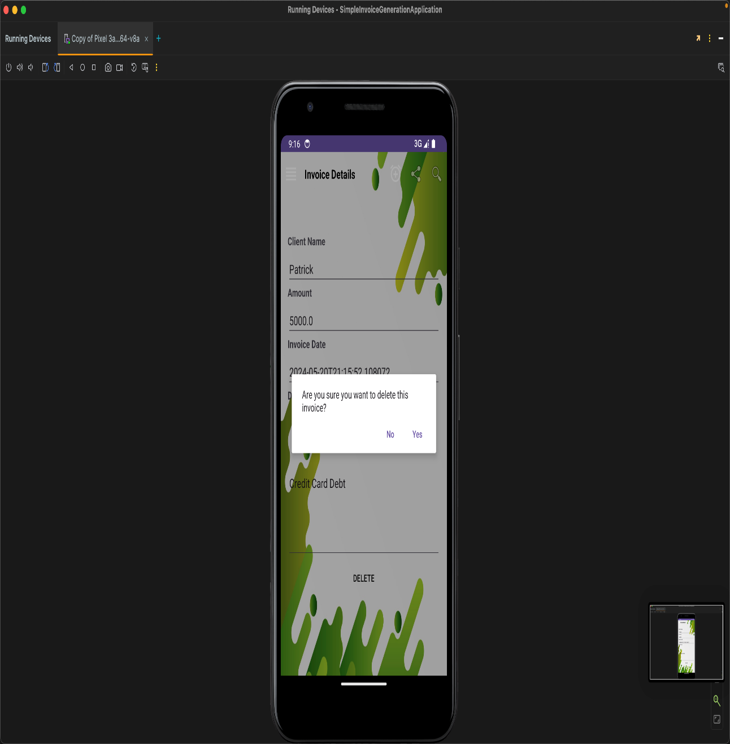
Application Review

